Slide 1

REPOSITORY SYNCHRONIZER
SRM INSTITUTE OF SCIENCE AND TECHNOLOGY COLLEGE OF ENGINEERING AND TECHNOLOGY DEPARTMENT OF NETWORKING AND COMMUNICATIONS 21CSC202J-OPERATING SYSTEMS , MINI-PROJECT PRESENTATION
Submitted by:
Kirithik-RA2211003010138
Harshed-RA2211003010143
Mukilan-RA2211003010146

Slide 2
OBJECTIVE
Objective is to write a program for
repository synchronizer using c

Slide 3
PROBLEM STATEMENT
Git repositories are often distributed across multiple machines, making it difficult to keep them up-to-date. This can be a problem for developers who need to collaborate on projects or who need to deploy their code to multiple machines.
Repository Synchronizer is a tool that solves this problem by providing a convenient and easy-to-use way to synchronize git repositories. Repository Synchronizer can be used to clone repositories, pull repositories, and push repositories. It can also be used to handle repositories that are located on remote servers.

Slide 4
ALGORITHM
Initialization:
Define the repositories or data stores that need to be synchronized.
Set up the necessary data structures to keep track of synchronization tasks and status.
Configure synchronization policies, such as synchronization frequency and conflict resolution strategies.
Monitoring Changes:
Continuously monitor the repositories for changes, additions, deletions, or updates.
Track the timestamp or version information for each file or data item in the repository.
Detecting Changes:
When a change is detected in one repository, record the change details, including the file affected and the nature of the change (addition, modification, deletion).
Determine if the change was made locally or remotely.
Conflict Resolution:
If conflicts are detected (i.e., changes in multiple repositories to the same file), implement a conflict resolution strategy. This could involve user interaction or automated conflict resolution rules.
Common conflict resolution strategies include "last writer wins," "merge changes," or user prompt for manual resolution.
Synchronization Process:
Initiate synchronization tasks based on the recorded changes.
For local changes, apply them to the remote repositories, and vice versa for remote changes.
Ensure that all changes are propagated in a way that maintains data consistency.
Version Control:
Keep track of versions of files or data items to enable rollback or history retrieval.
Maintain a version history log with timestamps and descriptions of changes.
Error Handling:
Implement error handling and retry mechanisms in case of network issues, repository unavailability, or other failures.
Log and report errors for diagnostics and troubleshooting.
Synchronization Policies:
Enforce synchronization policies defined during initialization, such as synchronization frequency, bandwidth usage limits, or exclusion rules for specific files or directories.
Feedback and Reporting:
Provide feedback to users or administrators about the status of synchronization tasks, including success, failures, and conflicts.
Generate reports or logs for auditing and analysis.
Termination:
Implement graceful termination procedures for the synchronizer.
Release resources and ensure that all pending synchronization tasks are completed.

Slide 5
FLOW CHART
Start
Check if the source repository exists
Yes
No
|
|
Print an error message and exit
Check if the destination repository exists
Yes
No
|
|
Create the destination directory
Check if the source repository is a git repository
Yes
No
|
|
Print an error message and exit
Check if the destination repository is a git repository
Yes
No
|
|
Clone the source repository to the destination directory
Pull the destination repository
End

Slide 6
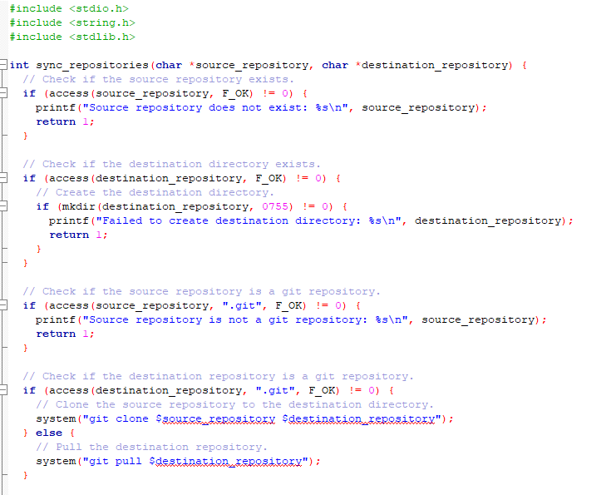
CODE SNIPPET

Slide 7
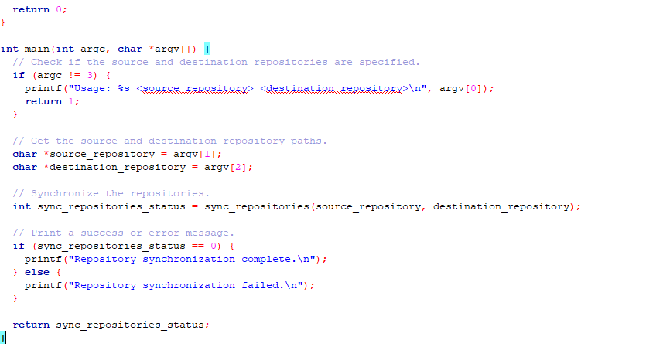

Slide 8

OUTPUT
Here is an example of the output of the program when the source and destination repositories are both git repositories:

Slide 9
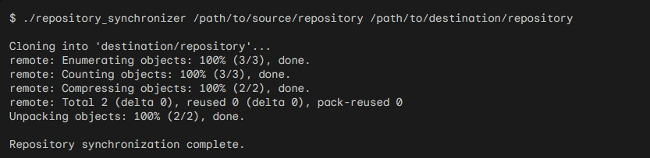
Here is an example of the output of the program when the source repository exists but the destination repository does not exist:

Slide 10

Here is an example of the output of the program when the source repository is not a git repository:

Slide 11
THANK YOU

